Slide 1


CIG – Change Initiation Gate
TCP Prepare WORK ID

Slide 2
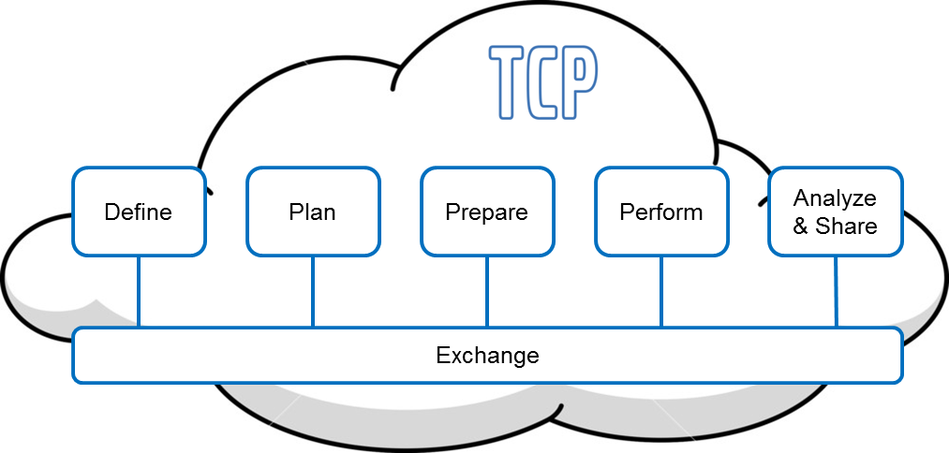













Initiatives
Exchange Platform (TCPX)
Initiatives
GHOST
Initiatives
Information Board
Initiatives
Test Manager - Prepare
Initiatives
Next RDM
Next EFACTS
Test Manager - Perform
Initiatives
Global Test Data Management
Today’s initiative

Slide 3
Content
Management summary and Status report
Business Objectives Management
Solution Management
Business Change Management
Project Control
Decisions
Appendix

Slide 4
Content
Management summary and Status report
Business Objectives Management
Solution Management
Business Change Management
Project Control
Decisions
Appendix

Slide 5
Management Summary
A pre prestudy has been performed looking into how to replace current solutions that support test of complete vehicles within FVV, result was a road map divided into four steps
This project will address step 1 in the suggested road map
Implement a Test Manager prepare test – core functionality
Disable and decommission PVT Manager

Slide 6
Suggested Roadmap
* May 2018
Step 1
Step 2
Step 3
Step 4
Test Manager
Prepare test - core
Test Manager
Perform test - core
Replace\update RDM
Test Manager
Prepare test - Extended
Disable PVT manager
Replace Efacts functionality
Test Manager
Perform test - Extended
Establish new TM with it’s own Database
Extend test specification with procedure(test method) and routine
Improve filtering test cases towards test object
Secure information exchange between New TM and Efacts
Establish basic system functionality for tester through tablet
Replace RDM functionality
Replace Efacts
Extend prepare test functionality
Extend perform test functionality
* =P2952 (FH and FM update)

Slide 7
Motivation – Step 1
Start building solution from beginning of the process is a prefered approach
Will secure quality from beginning of process
Todays PVT Manager does not meet PVTs or other groups needs
All groups ”except for field testing” have a need of a test preparation tool to get rid of all manual handling and get a common way of store test specifications
A new test structure is needed (Test methods, routines, test sequence, test case etc.)
Getting it right from beginning sorting out valid test cases for a certain test object spec. will help to avoid not valid testing that will create unnecessary work down streams in the process
Test Manager - prepare test is a precondition to build Test manager – perform test.
Test Manager will be separated from Efacts legacy
Removing PVT Manager will reduce complexity in legacy solution

Slide 8
Content
Management summary and Status report
Business Objectives Management
Solution Management
Business Change Management
Project Control
Decisions
Appendix

Slide 9
Problem and Opportunity statement
Requester / benefit realization owner
Lars Forsman – Feature Validation and Verification
Purpose, problem and opportunity description
Purpose with this project is to start replacing system solutions used within complete vehicle testing. These systems has met their end of life and has been condemned in EA reviews. A new solution will improve opportunities to fulfill test work in a more efficient way. This is required to met future challenges. This project will focus on developing prepare test functionality.
Business objectives based on Business Requirements (BR)
Business objective is to be able to meet current and future demand when it comes to testing of complete vehicles. Electrical platforms in vehicles sets demand on more effective system support for test activities, There is also a need of better performance, scalability and adjustability of future systems. The future solution also need to support the process in a more effective way.
Common system tools will also streamline the test work and this will open up possibilities to collaborate in a better way globally within groups but also ”cross functional” between groups within FVV.
The overall objective is of course to be able to test products effectively and to get them out on the market as fast as possible with the right quality so that Volvo can get revenue on sales. This specific initiative will improve the process step ”Prepare test”.
Impact on business
Business roles within complete vehicle testing will get system support and many today manual tasks will be supported by a system solution.

Slide 10
Project Vision and alignment with Strategic Objectives
Project vision
Vision is to develop and implement a scalable, stable and high-performing solution easily adaptable for future business demands supporting complete vehicle testing activities in an effective way. This initiative will support the process step “Prepare test”.
Project alignment with Volvo Group core values (Quality, Safety, Environmental Care), and Volvo Group policies and directives
Quality: We will secure quality in the delivery through use appointed solution components, work methods and the project will follow Volvo Group target architecture. Policies and directives will be followed.
Environment: The new system will improve work environment for roles involved in the process.
Safety: Better solution support will improve test work which in the end will lead to more secure products
Project alignment with Business strategic objectives and Corporate Process & IT strategy (including integration strategy and IT policies and directives) and roadmaps
This project will be a start of the realisation of the road map to develop future system solution/s for supporting Validation and Verification of complete vehicles. From an IT perspective we will follow ten architectural principals, Volvo group target architecture and VIAP(Volvo Group Infrastructure Architecture Policy).
Requirements breakdown – Strategic Objectives (SO): Business Req breakdown

Slide 11
Business Objectives
Based on Business Requirements (BR)
Replace PVT Manager used for preparing test cases and test sequences for complete vehicle testing.
Today PVT(Performance Validation Test) organization use this system but it does not meet their requirements anymore
PVT Manager does not follow volvo group target architecture and are built on not appointed components
It is hard to implement changes to support new business demands
Business suffer from problems that is caused from the design of the architecture
There is a need for a test manager solution for all groups within FVV to improve support in creating tests and test specifications and to get rid of the manual handling around this
A test manager solution will improve opportunities to share test documentation between sites and organizations in a more effective way.
It is also a need to change the test specification structure with new components(Test methods, routines etc.)
A new test manager – prepare test is a start to implement a solution that is stable, scalable with high-performance and more easily adaptable for future business demands

Slide 12
Project Scope
Based on Stakeholder Requirements (StR)
Assumptions and constraints:
This project will focus on test Manager – prepare test ( core functionality)
User organisation in focus to recieve the solution will be groups within Feature Validation &Verification(FVV).
In scope:
Specify and document core functionality for Test Manager – prepare test
Analyze, prototype ,design, develop and test core functionality of Test Manager – Prepare test
Proof of concept - technology
Test automation should be implemented to the extent possible
Make sure new developed functionality work togheter with Efacts
Identify and train users( develop user guides)
Migration of data and decommission of PVT Manager
Hand over solution to maintenance organisation(Deliver required documentation, hand over/training sessions etc.)
Roll out solution
Start requirement work for step 2 – Perform test
Out of scope:
We will not focus on RDM and Efacts at this point. EFACTS will not be in focus in this project but we need to make sure EFACTS works togheter with the new functionality introduced.
Impacted process 1: link Impacted process 2: link Requirements Breakdown – Stakeholder Requirements (StR): Business Requirement Breakdown

Slide 13
Impact from project dependencies
Project | CPM | Dependency | Impact
TCP Exchange | Ulf Krysell | We will need to send data to and recieve data from TCP | We need to have a constant dialogue and do some coordination in our planning.
GTDM | Ulf Krysell | This project might put requirements towards us for specific data. | We need to have a constant dialogue and GTDM need to specify their requirements towards us in good time for us to plan delivery of their needs.
System engineering: WP3 | Boel Björkman | This project work with terminology and other outcome that we might need to follow and adjust to | There could be some outcome that we need to take into account in our work.
Maintenance Legacy systems | Raphael Scotton, Pooja Shetty | There will be some development ongoing for exsisting legacy solutions. There might also be conflicting needs regarding resources | We need to make sure there is no development that will make it harder for us to execute our plan. Project and maintenance need to have a dialogue around what is in pipeline for development. If there will be conflicting resource needs there needs to be a dialogue about it.

Slide 14
Business Value and related business KPI's
Business value | Related KPI | Abililty of KPI to measure business value
Efficencies: perform just valid test cases towards a test object will reduce waste and lead to a more lean process | Reduce error reports on not valid tests | Not sure.
Share tests and test specifications between sites and groups | Reduce redundant work | Not sure
Improve test specification with new components. Will improve test work | Improve possibility to find errors before product hits the market | Not sure
Business case (Profitability calculation): link
Notes:
Ability of KPI to measure business value: Does the KPI makes it possible to measure a business value or needs to be adjusted

Slide 15
Content
Management summary and Status report
Business Objectives Management
Solution Management
Business Change Management
Project Control
Decisions
Appendix

Slide 16
Solution Management
EPIC Model(draft)
Information Model(draft)
High-level AS-IS and TO-BE solution
Volvo Group Target Architecture
Example on implementation of Volvo Group target architecture
Rich Web Client – Restful Services

Slide 17
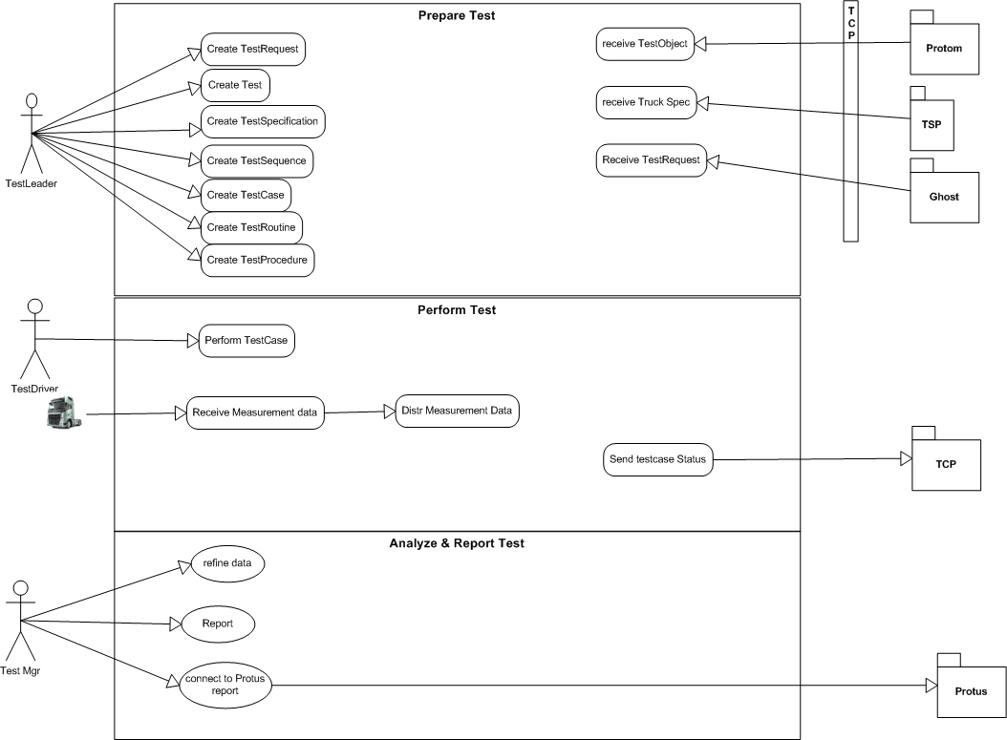
EPIC Model (draft)
– Only prepare test is in scope for this project

Slide 18
Draft Information Model

Slide 19
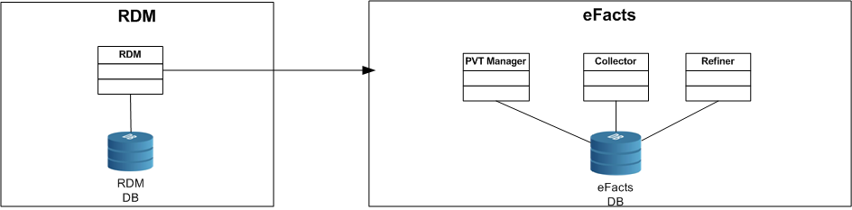
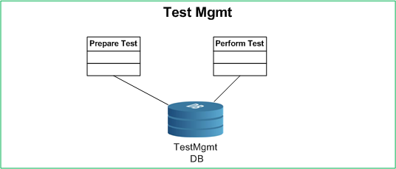
As Is
To Be
Step 1
Step 2

Slide 20
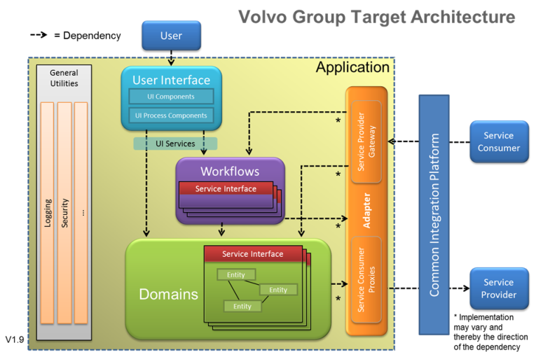

Slide 21
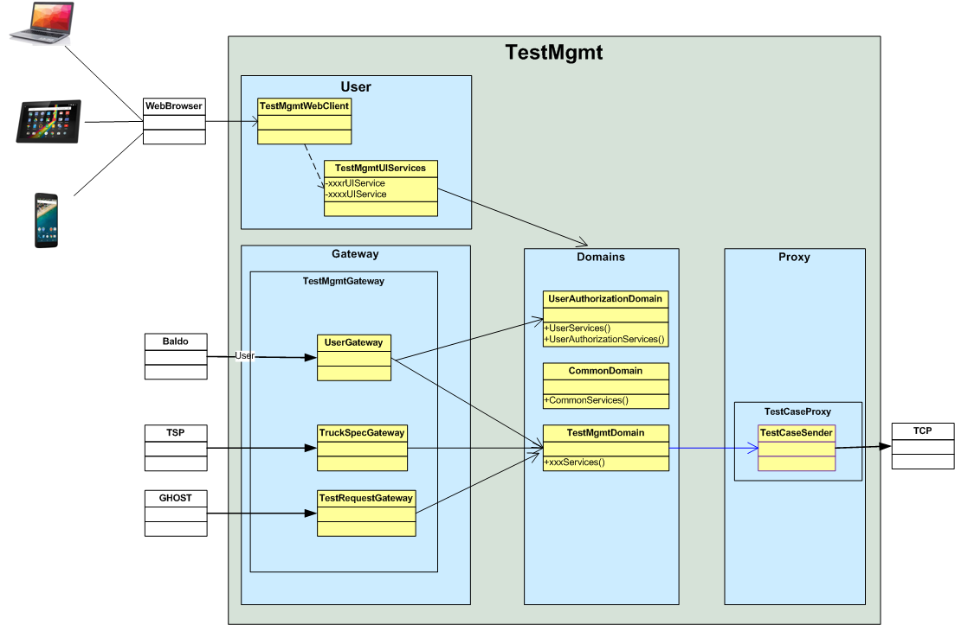
Example on implementation of Volvo Group target architecture

Slide 22
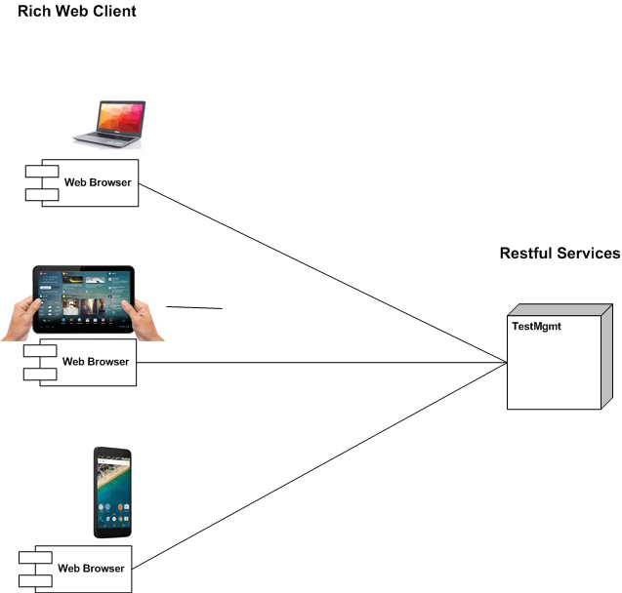
Rich Web Client – Restful Services

Slide 23
Content
Management summary and Status report
Business Objectives Management
Solution Management
Business Change Management
Project Control
Decisions
Appendix

Slide 24
Stakeholder List
Key stakeholders SC members
Appointed
Steering committe chairman: Lars Forsman
BSPM(Main stakeholder): Magnus Söder
Delivery Manager: Raphael Scotton
Other Key Stakeholders not SC members
FVV organization
Ulf Krysell CPM: TCP and GTDM
Stakeholders analysis and Management template: link

Slide 25
High level Stakeholder impact
TD/BA/CF* | Stakeholder Group | Impact magnitude
GTT FVV(Feature Verification and Validation) | AET\RT,PVT,Active safety, field testing | New system tools, for some it will be a big change
Stakeholders analysis and Management template: link
(*) TD/BA/CF: Truck Division(s) / Business Area(s) / Corporate Function(s)

Slide 26
Content
Management summary and Status report
Business Objectives Management
Solution Management
Business Change Management
Project Control
Decisions
Appendix

Slide 27
Time Plan for next phase up to CSG
Concept Study
Week/March
Detail project scope
Requirements breakdown – business part
Business Requirements Prototypes – different aspects
Develop Business Case
Secure resources(core team)
Detail PM-Plan
Analyse Impact project dependencies
Other relevant deliveries
Detailed phase schedule: link

Slide 28








Total Project Time Plan
TCP Prepare – core before June 2018 P2952
TCP Perform - Core
Month + year
Month + year
Month + year
Month + year
Month + year
Month + year
Month + year
2016-01-26
2017-03-03
2017-04-15
2017-06-10
2017-12-15
2018-01-31
2018-02-15
Concept study
Concept
development
Detailed
requirement
development
Solution
development
Final verification
&
industrialization
Implementation

Slide 29




Project organization
Steering Committe
CPM\ITPM – Martin A
Lead Architect – Per Lövdinger
Business Analyst – Jonas Qvist
Test Manager – shared with TCP\GTDM
Project core team
Lars Forsman
BSPM – Magnus Söder
DM – Raphael Scotton
One development team
Business reference group
Swedish Development team
India Development team
Arto Mantilla
Tim Jansson
Martin Svennungsson
Jonas Qvist
PVT functional Manager
Thomas Voigt
Magnus Ström
Lead Architect – Per L
Server Software Architect -TBD
Client Software Architect - TBD
Senior developer - TBD
Experienced developer - TBD
Experienced developer - TBD
Integration Architect - TBD

Slide 30
Project Cost and Budget
Approx. 7 Msek, 2017 IT budget
Budget plan details: link

Slide 31
Project Organization
CPM: Martin Andersson
Project team:
Lead Architect: Per Lövdinger
Business Analyst: Jonas Qvist
IT:
Solution Architect: Per Lövdinger
ITPM: Martin Andersson
Process & IT Sourcing & Purchasing lead:
N/A at the moment
Steering Committee Chairman: Lars Forsman
Status of project resources (secured / missing):
Resources needed to next gate has been secured

Slide 32
Project Execution Communication
Project Execution Communication target groups and their characteristics:
FVV(Feature validation and verification) major stakeholders
TCP(Test Collaboration Platform)
GTDM(Global Test Data Management)
Maintenance team – Legacy applications
Project Execution Communication plan:
We will inform when project start
We will decide togheter with major stakeholders the level of communication required during execution of project
We will also decide upon which foras should be set up and how often they will occur

Slide 33
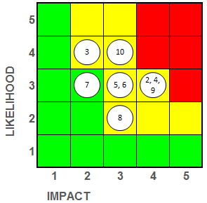
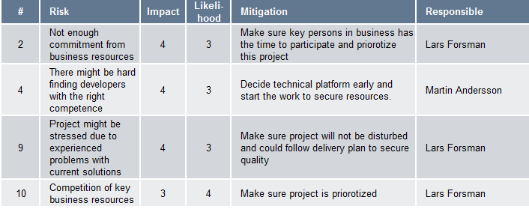
Risk Analysis
Detailed Risk Analysis: Risk analysis§

Slide 34
Content
Management summary and Status report
Business Objectives Management
Solution Management
Business Change Management
Project Control
Decisions
Appendix

Slide 35
Expected Decisions – CIG Gate Opening Criteria's
Subject | Decision | Comment
Approve hand-over of main deliverables initiated in the portfolio management to the project
Approve the business Value of the request
Confirm that there is a need and management awareness to change
Appoint CPM or approve CPM appointment – Martin Andersson suggested as CPM
Confirm SC chairman appointment and SC members composition | Chairman: Lars Forsman Magnus Söder Raphael Scotton
Approve budget, time plan and commitment of resources (business and IT) up to next gate

Slide 36
Additional Decisions made during the meeting Date: 201X-XX-XX
Decision # | Decision taken
1 | …
2 | …
3 | …

Slide 37
Additional actions decided during the meeting Date: 201X-XX-XX
Action # | Description | Responsible | Due date
1 | …
2 | …
3 | …

